Slide 1
Customer Segmentation CDACL-002
Name: Ranganatha R
Batch ID: 11-AUG-25-CDA-BUN-040-WDM1130-BAN
Project Team ID: PTID-CDA-NOV-25-934

Slide 2
Dataset Overview and Objective:
Dataset Overview:
U.S. customer shopping data with 3,900 records
Covers demographics, spending, discounts, payment methods, seasons, and locations
Includes purchase behavior and engagement metrics such as frequency, previous purchases, and subscriptions
Captures customer feedback and promotion impact through ratings, discounts, and promo usage
Problem Statement:
Identify discount-eligible product categories
Analyze card spending by age, season, and location
Segment customers and design targeted strategies
Objective: To analyze customer shopping behavior using SQL and Power BI, identify spending and discount patterns, segment customers based on trends, and provide actionable insights to support targeted marketing and business decisions.

Slide 3
Task Flow
Understood project objectives and dataset structure.
Planned workflow by dividing tasks across SQL, Power BI, and PPT.
SQL
Connected to database and explored data.
Verified data quality and created age groups.
Analyzed spending by category, discount, season, location, and payment method.
Power BI
Imported data and created KPIs.
Performed customer clustering and segment analysis.
Built dashboard and supporting visuals.
Derived insights and recommendations.
Presentation
Structured slides and refined content.
Finalized visuals, insights, and recommendations.
Recorded and submitted the project.
CDACL-002-C S.docx
For Detailed Work Flow, click here:

Slide 4
Customer Segmentation Approach:
Customers were segmented using Purchase Amount and Previous Purchases to capture value and engagement.
Clustering resulted in High, Medium, and Low value customer groups based on spending behavior.
These variables were chosen as they best represent customer lifetime value and shopping consistency.
Segmentation enables targeted marketing strategies instead of one-size-fits-all promotions.

Slide 5
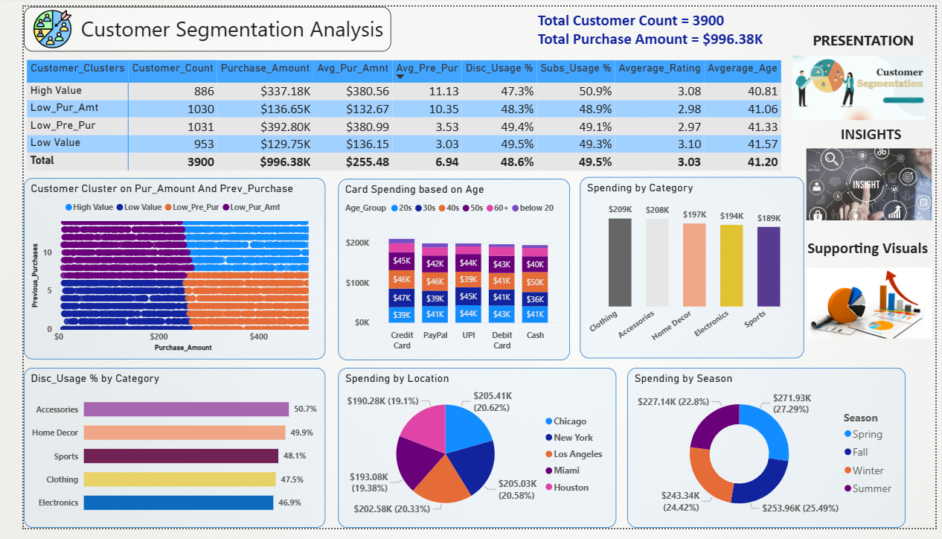

Slide 6
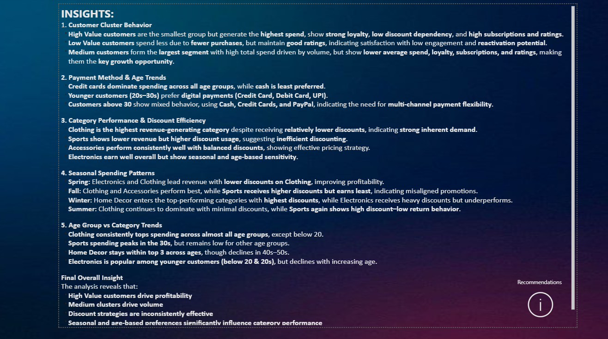
INSIGHTS:
Customer clustering reveals clear High, Medium, and Low value segments with distinct spending and loyalty behaviors.
High-value customers, though fewer, contribute the highest profitability with strong loyalty and low discount dependency.
Medium customer segments drive volume but show lower loyalty and satisfaction, indicating strong growth potential.
Credit cards dominate payments, with younger customers preferring digital methods.
Clothing consistently leads revenue across ages and seasons with minimal discount reliance.
Discounts are least effective in Sports, showing high discount but low revenue impact.
Seasonal and age-based preferences significantly influence category performance.
Location impact was analyzed and found to be relatively uniform, hence not a primary driver compared to seasonality.
(For detailed insights, refer to the interactive Power BI dashboard)

Slide 7
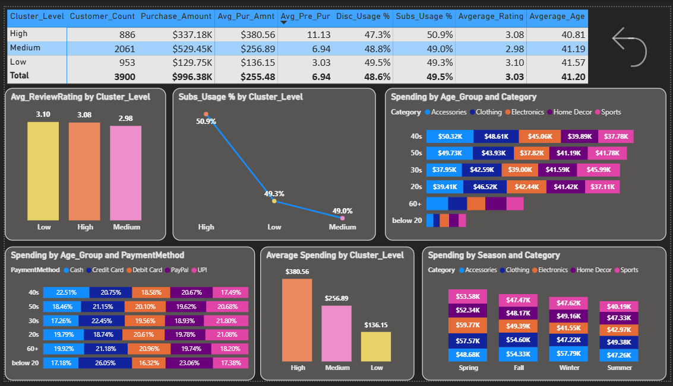

Slide 8
RECOMMENDATIONS:
1.Prioritize retention of High Value customers through exclusive benefits, not discounts, to protect margins.
2.Focus upsell and engagement strategies on Medium clusters, using targeted offers, bundles, and loyalty programs.
3.Reengage Low Value customers with personalized campaigns to increase purchase frequency.
4.Optimize discount strategy, especially for Sports and Electronics where high discounts yield low returns.
5.Leverage Clothing’s strong demand by maintaining pricing power and introducing premium variants.
6.Leverage seasonal demand by aligning promotions with high-performing categories per season.
7.Optimize seasonal promotions, especially in Winter and Fall, aligning discounts with actual demand drivers.
8.Enhance digital payment experiences for younger customers while maintaining flexible options for older age groups.

Slide 9
Conclusion:
Customer segmentation clearly differentiates value-driven and volume-driven customers.
Customer behavior varies significantly by value segment, age, and season
Discount effectiveness varies by category and season. Targeted discounts and campaigns can improve profitability and engagement
Insights from this analysis enable data-driven decisions for pricing, promotions, and customer targeting.

Slide 10
REFERENCES:
Power BI Dashboard:
SQL Analysis:
Detailed Workflow:
CDACL-002-C S.pbix
CDACL-002-C S
CDACL-002-C S.docx

Slide 11
Thank You

